Slide 1
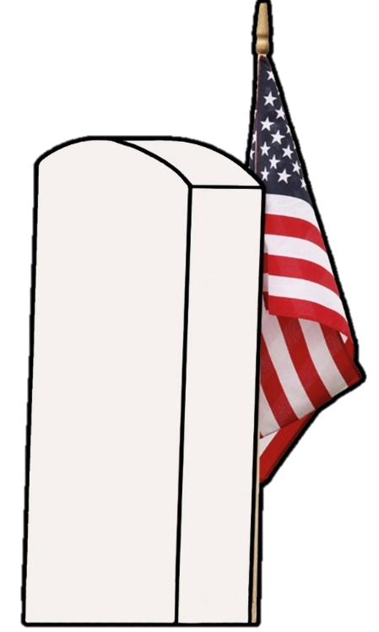

Revolutionary War Patriot GRAVE MARKING
Pvt. Johannes Bock
Presented by Jacob R. Lemon
President of the Harris Ferry Chapter
Sons of the American Revolution

Slide 2
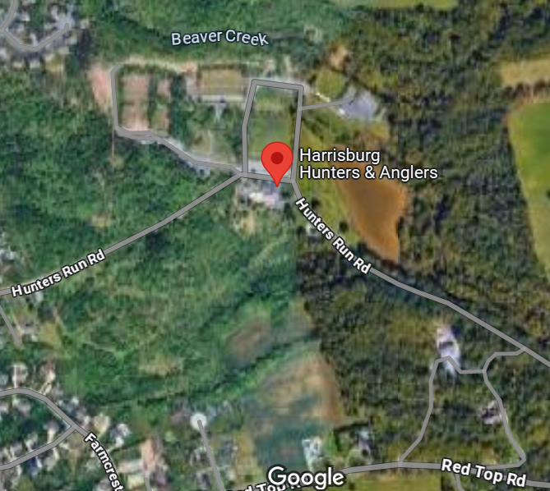
Date, Time, & Location
Harrisburg Hunters’ & Anglers’ Association
6611 Hunters Run Rd, Harrisburg, PA 17111
APR 26 2025
SAT
10
AM
Grave Marking Ceremony – Patriot Johannes Bock

Slide 3

Patriot Biography
John “Johannes Bock” Buck
02 Jan 1753 – 07 Aug 1822
SAR Patriot #: P-116966
Moved from Germany to present-day Dauphin Co.
Married Gertrude and had eight children.
Purchased land that is now owned by HHAA.
Enlisted in 1776 and served until 1782.
Served alongside other Dauphin Co. men.
Passed away at age 69 and is buried with family.
Johannes Bock
1753 - 1822
Grave Marking Ceremony – Patriot Johannes Bock

Slide 4

Sons of the American Revolution
The Sons of the American Revolution honors our Revolutionary War patriot ancestors by promoting patriotism, serving our communities and educating and inspiring future generations about the founding principles of our Country.
If you have a patriot ancestor and would like to learn about joining, please ask any one of the SAR Compatriots that are here today.
Grave Marking Ceremony – Patriot Johannes Bock

Slide 5

Daughters of the American Revolution
The National Society Daughters of the American Revolution was founded in 1890 to promote Historic Preservation, Education, and Patriotism across the United States. Since the Society's founding, more than one million women have found purpose and passion in DAR membership.
Grave Marking Ceremony – Patriot Johannes Bock

Slide 6

Harrisburg Hunters’ & Anglers’ Association
One of the most complete sporting facilities in the East since 1945, the Harrisburg Hunters’ & Anglers’ Association offering a variety of programs and facilities for outdoor enthusiasts.
Grave Marking Ceremony – Patriot Johannes Bock

Slide 7
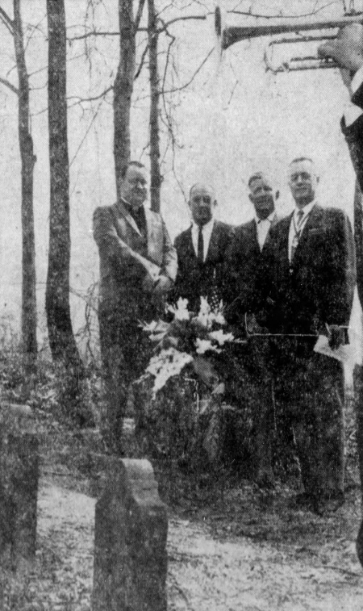
Buck Cemetery – History
Rediscovered in 1963 by a group of playing children.
HHAA President Hoffer requested HFSAR to dedicate the cemetery, which President Savage helped conduct alongside Rev. James Smith and descendant Luther Buck.
Since then, Buck Cemetery has been under the careful and respectful maintenance of HHAA.
Grave Marking Ceremony – Patriot Johannes Bock

Slide 8
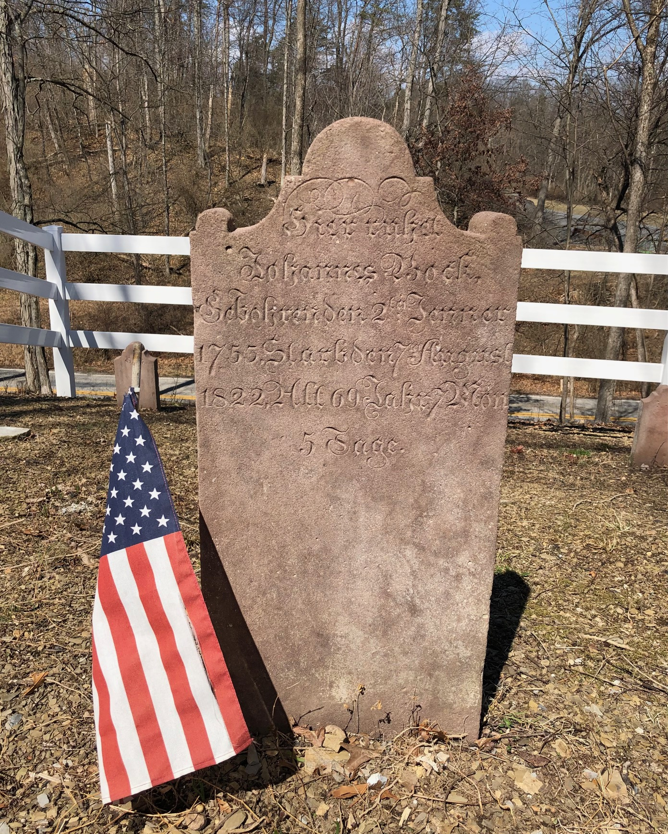

Buck Cemetery – Today
New white vinyl fence, curtesy of Eagle Scout Jaden Morgans.
SAR Patriot Grave Marker and Revolutionary War Grave Marker, curtesy of Harris Ferry Chapter SAR.
Pomeroy Foundation Roadside Marker (to be installed soon).
Cemented in history as playing a part in the 250th Anniversary of the United States of America.
Grave Marking Ceremony – Patriot Johannes Bock

Slide 9

Credits
This presentation, the photos and knowledge within it, were all sourced from Harris Ferry Chapter SAR President Jacob R. Lemon. It was presented at the Harrisburg Hunters’ & Anglers’ Association in Harrisburg, PA on April 26, 2025. If anyone has any questions or comments, feel free to utilize the following contact information:
Jacob R. Lemon
(717) 507-5364
jlemon93@hotmail.com
Grave Marking Ceremony – Patriot Johannes Bock

