Slide 1
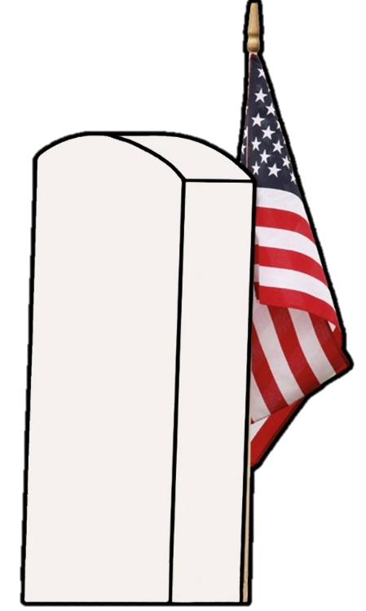
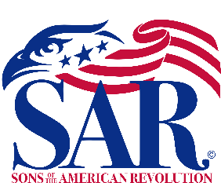
TOMBSTONE RESTORATION & PRESERVATION
Historical Techniques for Abandoned Cemeteries
Presented by Jacob R. Lemon
President of the Harris Ferry Chapter
Sons of the American Revolution

Slide 2
Types of Tombstone & Cemetery Work
Ground Maintenance
Resetting & Leveling
Grass cutting, weed management, brush removal,
tree limb safety, and animal infestation control
Ground leveling, stone-to-stone bonding,
mortaring and repointing, and rigging
Monument Cleaning
Repairing
Cleaning, graffiti removal, tools and chemicals,
and damage safety analyzation
Crack and tablet repair, infilling, stone cutting,
and base reconstruction
Tombstone Restoration & Preservation

Slide 3
Ground Maintenance
Grass Cutting
Weed Management
Brush Removal
Tree Limb Safety
Animal Infestation Control
Essential part to keeping a cemetery safe and preserved. Uncontrolled foliage can not only attract wild critters, but overgrowth will attack stones and cause toppling, adhesion to stones, and other problems. Cemetery neglect can also attract vandalism. Grounds maintenance is usually a responsibility of the property owner or affiliated church; if the owner passes or church dissolves, cemeteries are usually an afterthought even to families. Most churches do not fund any sort of cemetery work other than mowing, leaving monuments defenseless.
Tombstone Restoration & Preservation

Slide 4
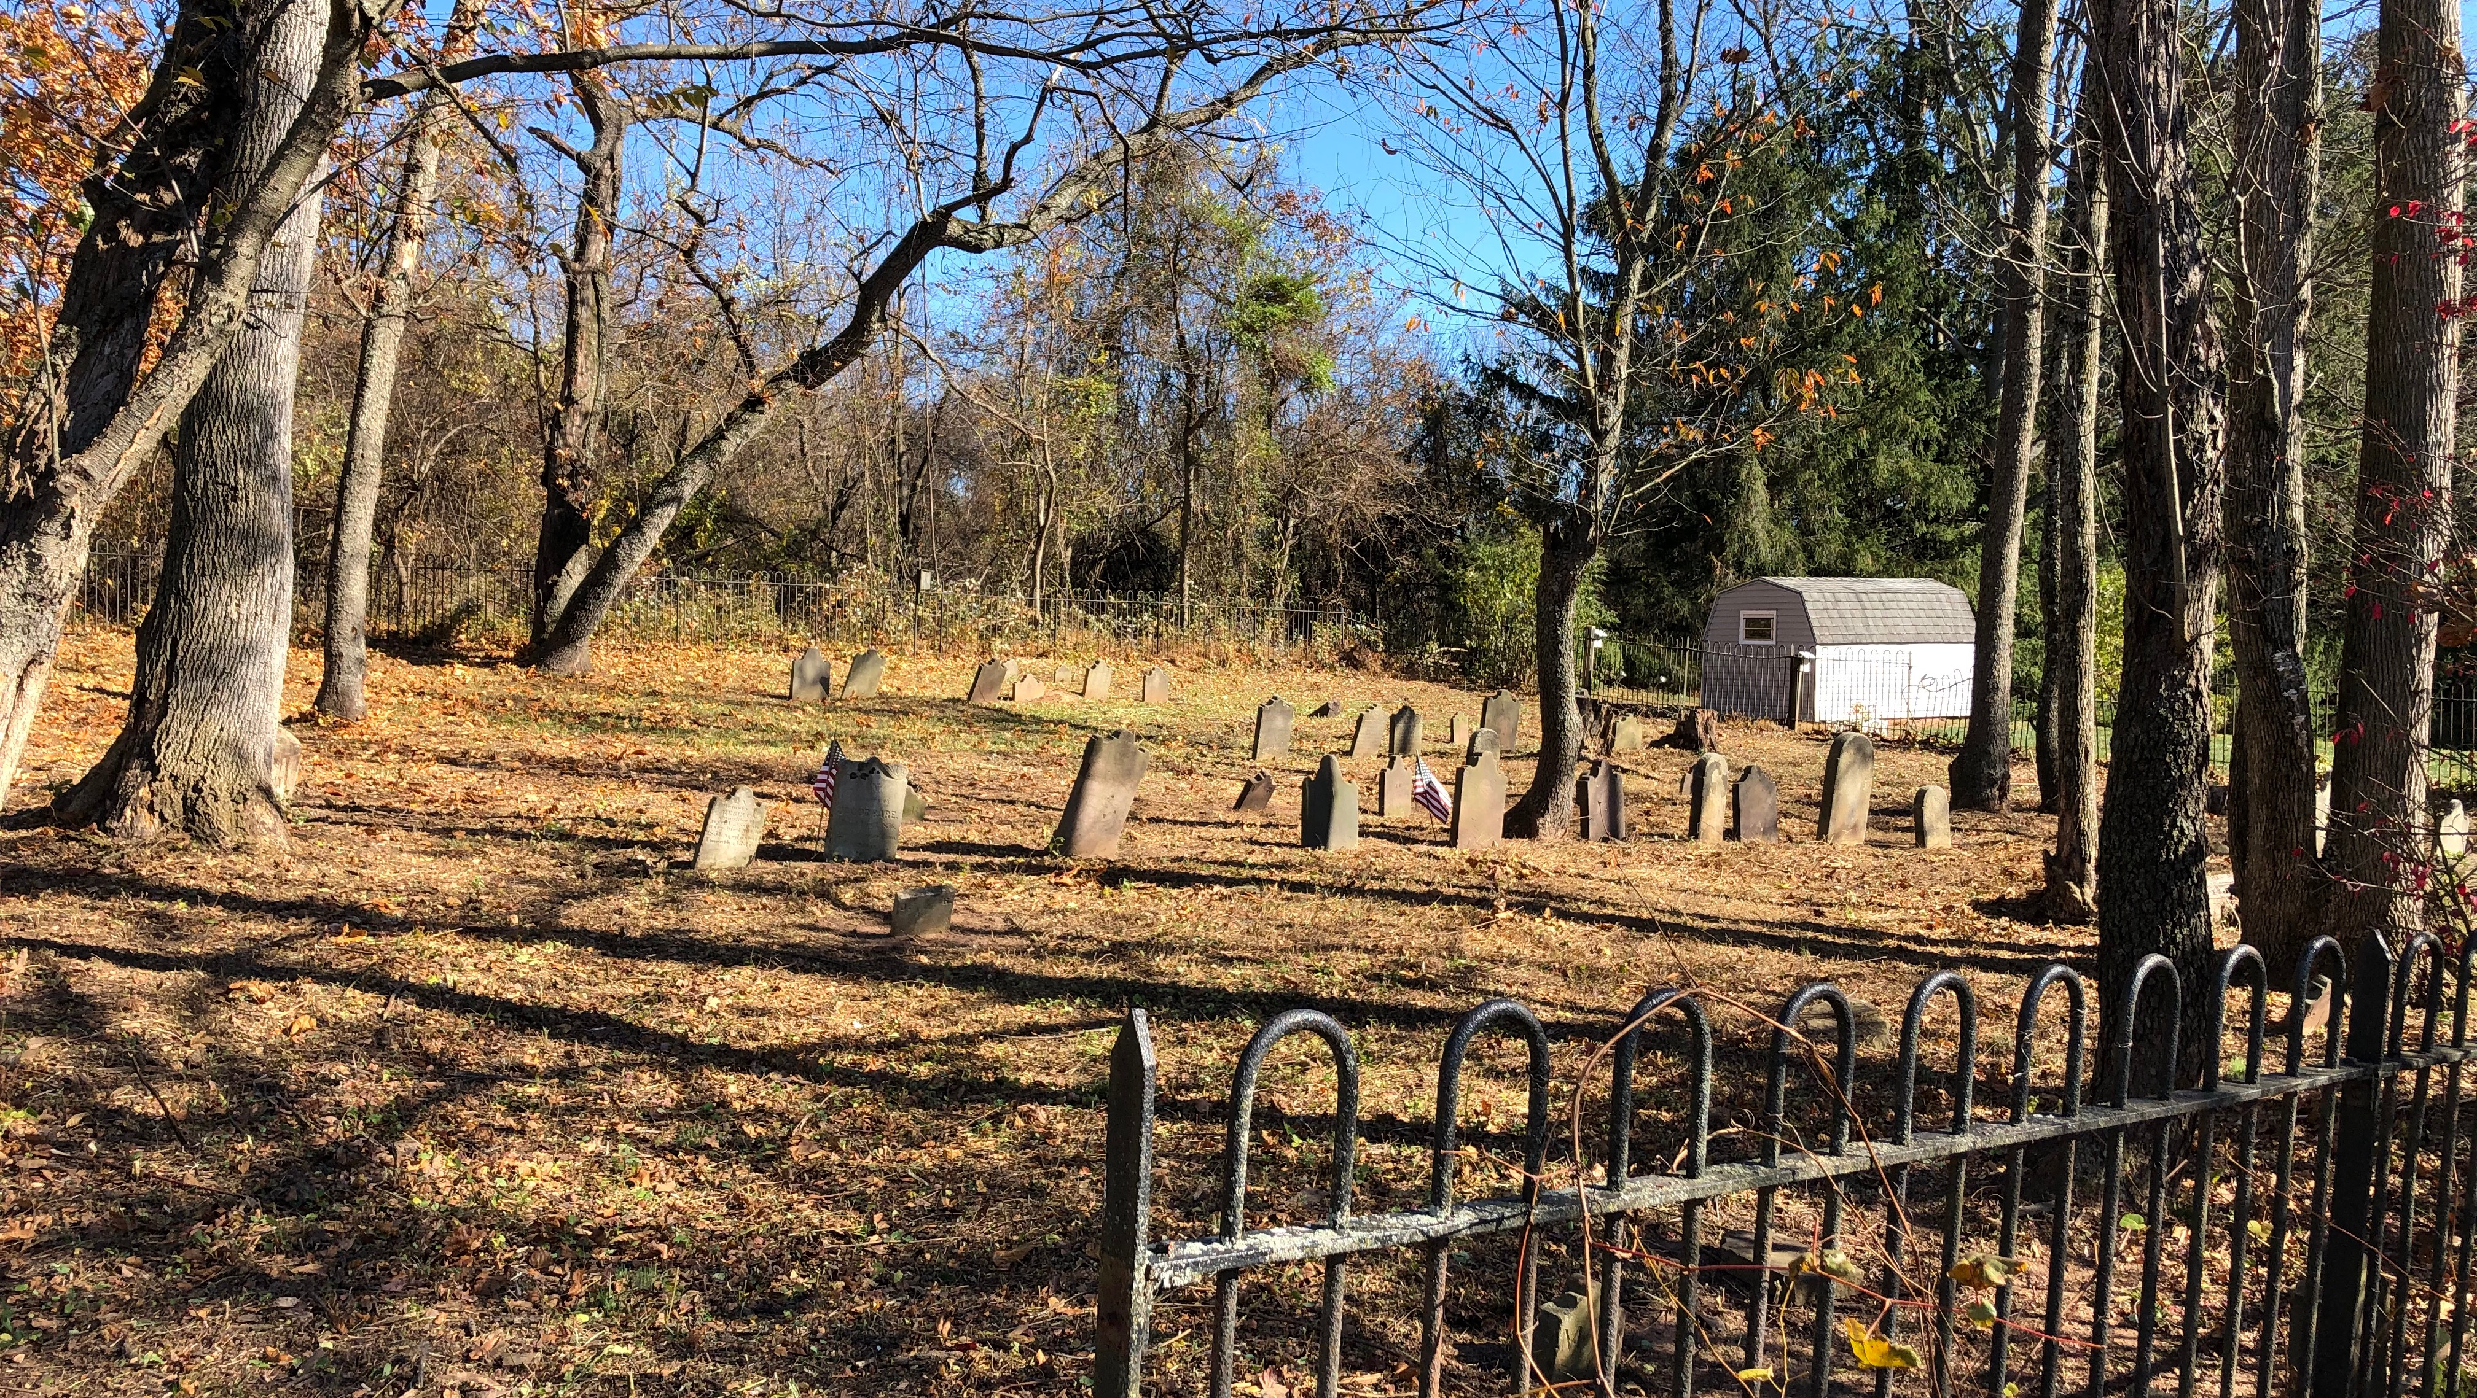
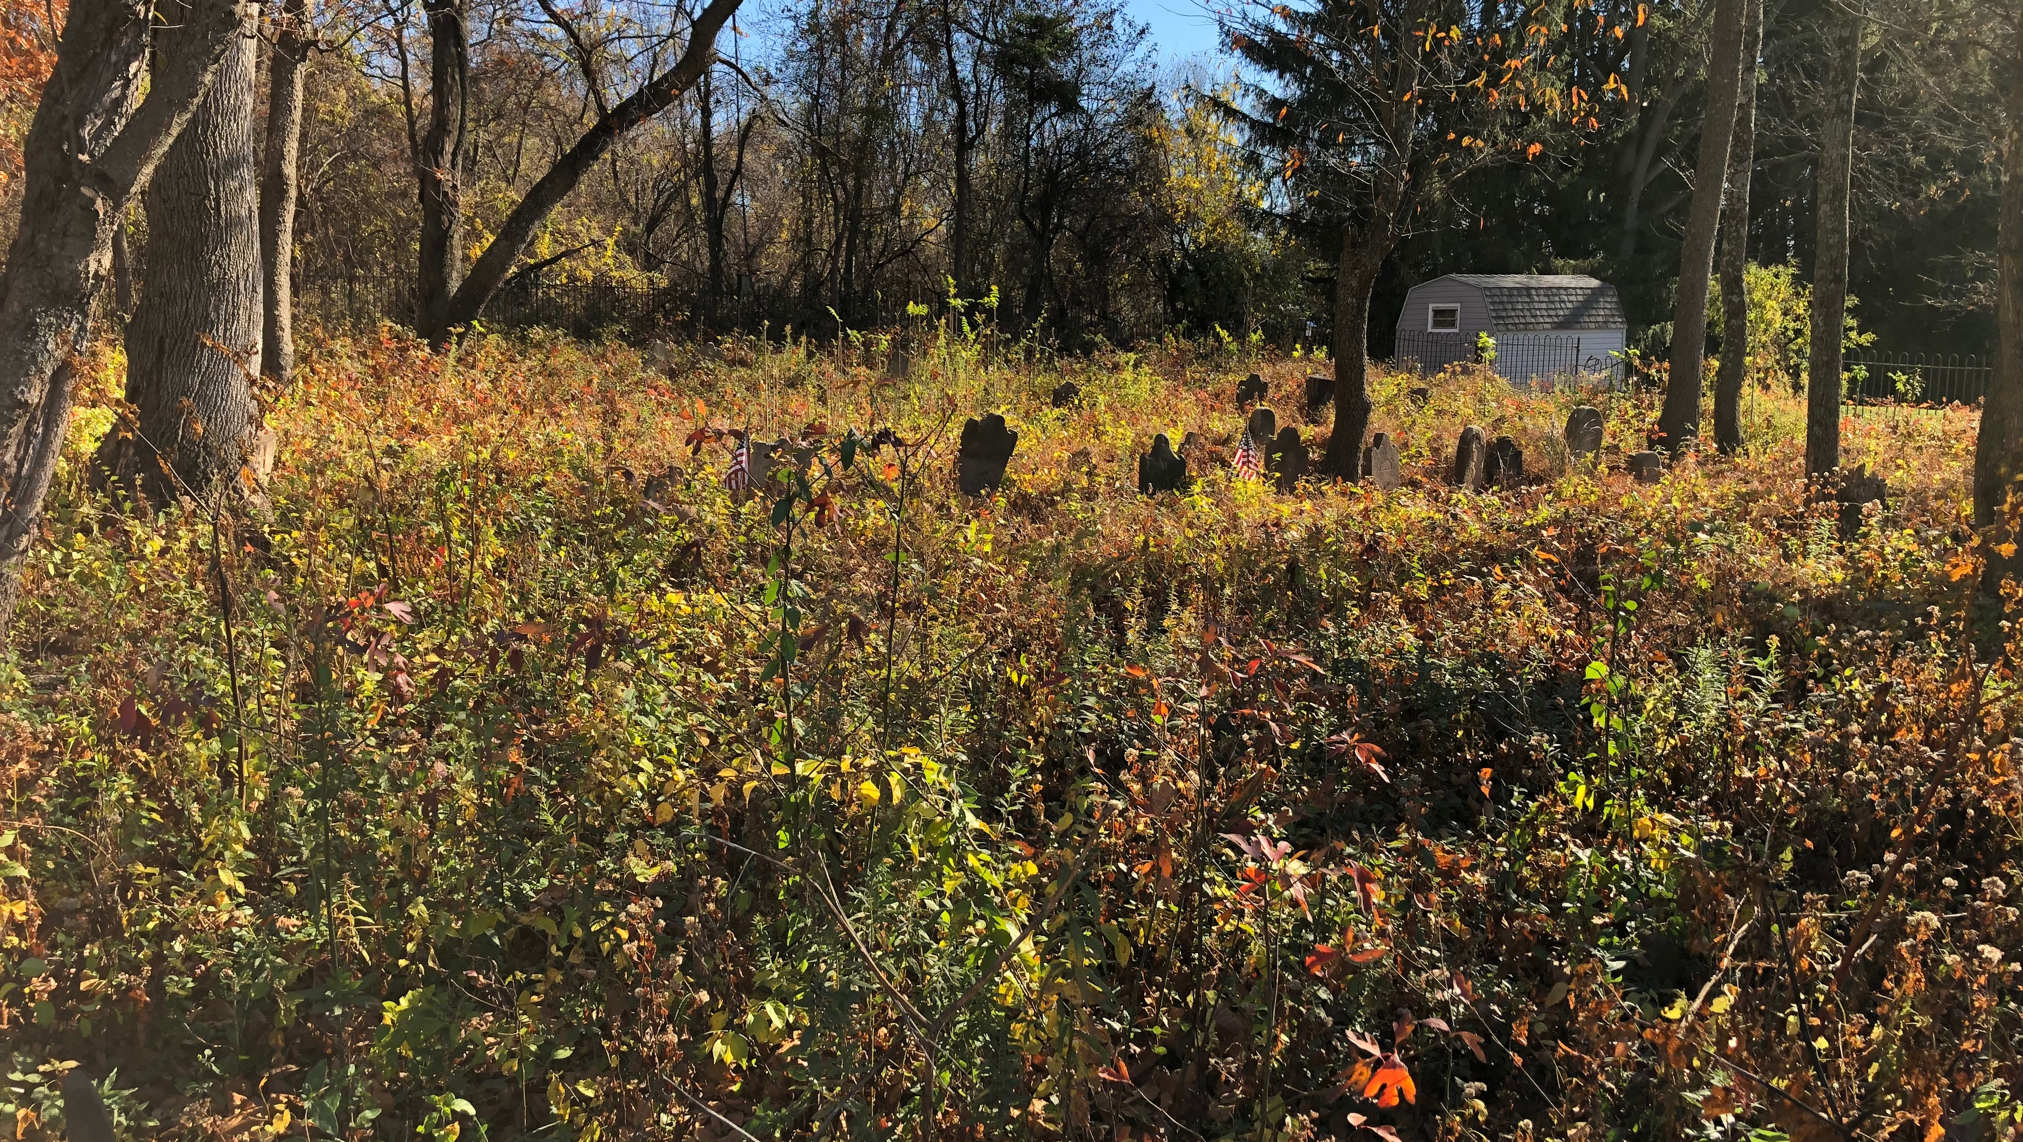
Ground Maintenance
Tombstone Restoration & Preservation

Slide 5
Resetting & Leveling
Ground Leveling
Stone-to-Stone Bonding
Mortaring & Repointing
Rigging
Most older cemeteries have stones that are leaning or have already fallen to the ground. Using hoists and jacks, stones can be safely moved to then reposition them safely in the ground with added stone and sand for leveling. Setting the stone in concrete is not advised. Monuments that have flush components, often secured with lead, sulfur, and iron pins, can be bonded together with modern epoxies. Tablet stones that fit into a keyway base require historic pointing mortar and masonry.
Tombstone Restoration & Preservation

Slide 6
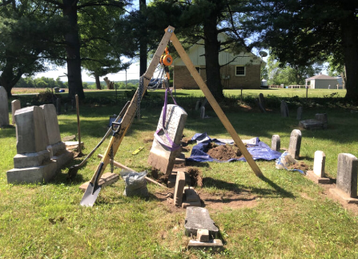
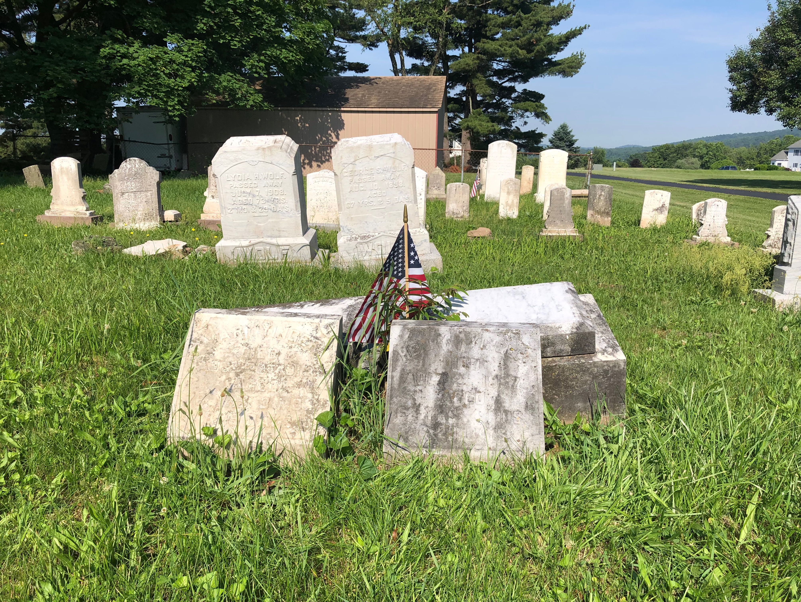
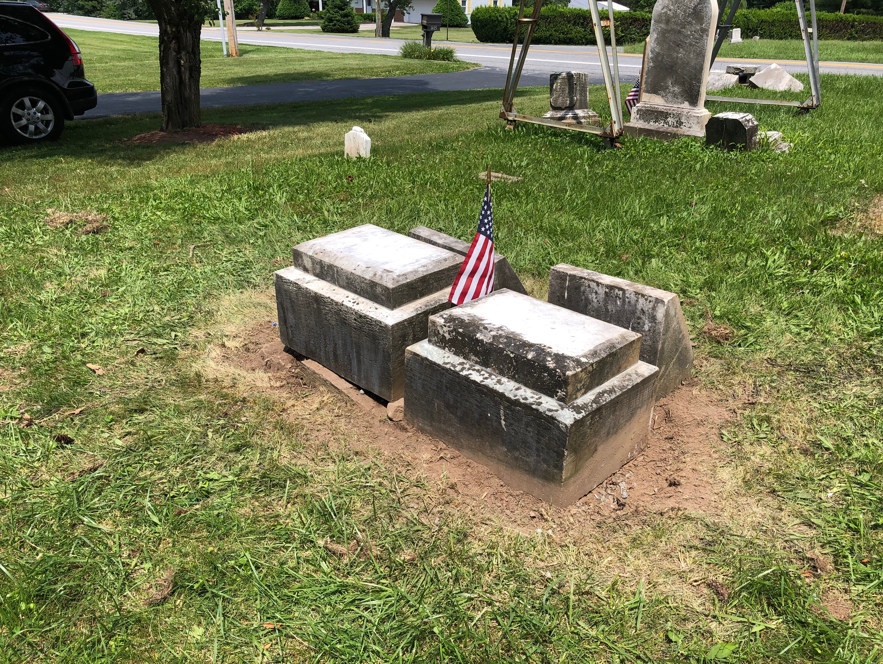
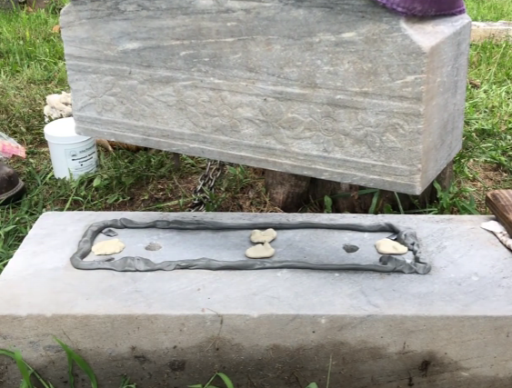
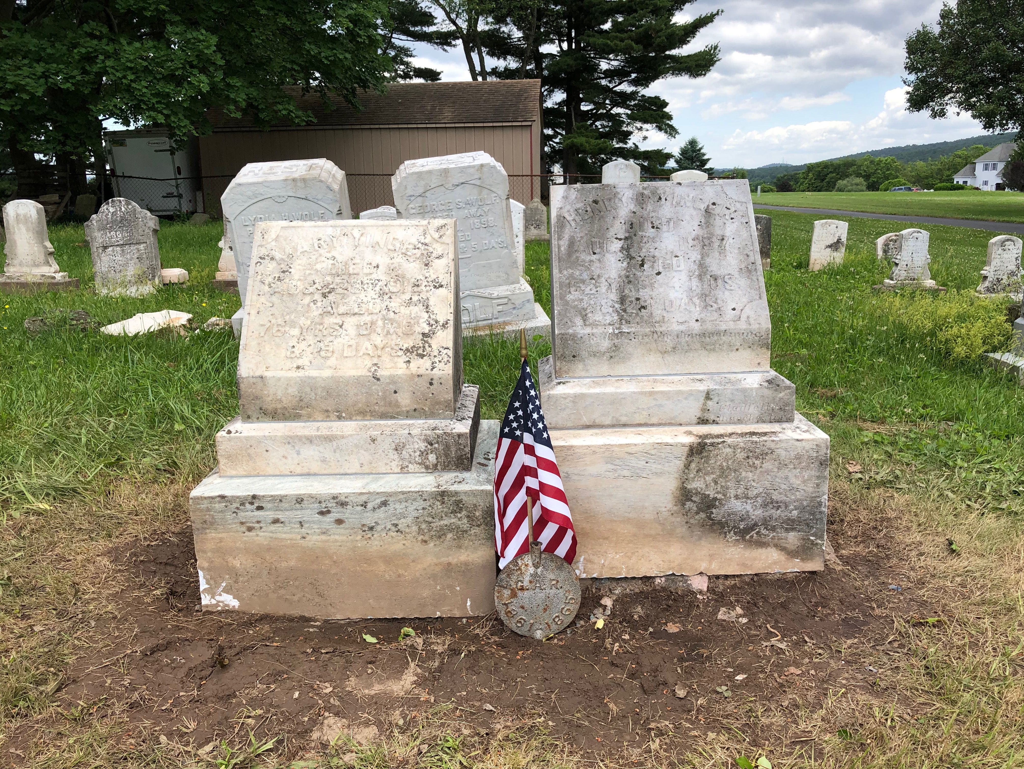
Resetting & Leveling
Tombstone Restoration & Preservation

Slide 7
Monument Cleaning
Cleaning
Graffiti Removal
Tools and Chemicals
Damage Safety Analyzation
Before working on any monument, the first to steps are to request permission to the property if applicable and to verify the structure is stable to work on. If there is danger to yourself, others, or the stone, it is best to reassess the situation. Appropriate cleaning agents are D/2 Biological Solution and Wet & Forget. Fresh drinking water, soft bristle brushes, plastic scrapers, and a low-pressure pump sprayer should be used. Under no circumstances should bleach, metal brushes, or pressure washers be anywhere near a tombstone. Regarding graffiti, special attention and cleaners should be used.
Tombstone Restoration & Preservation

Slide 8
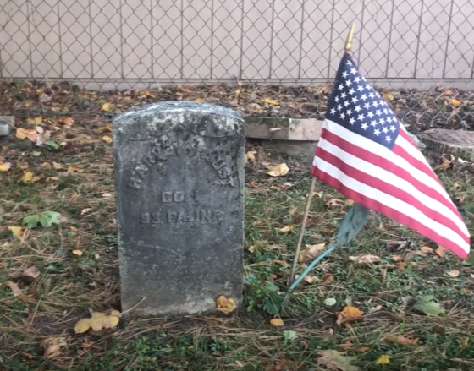
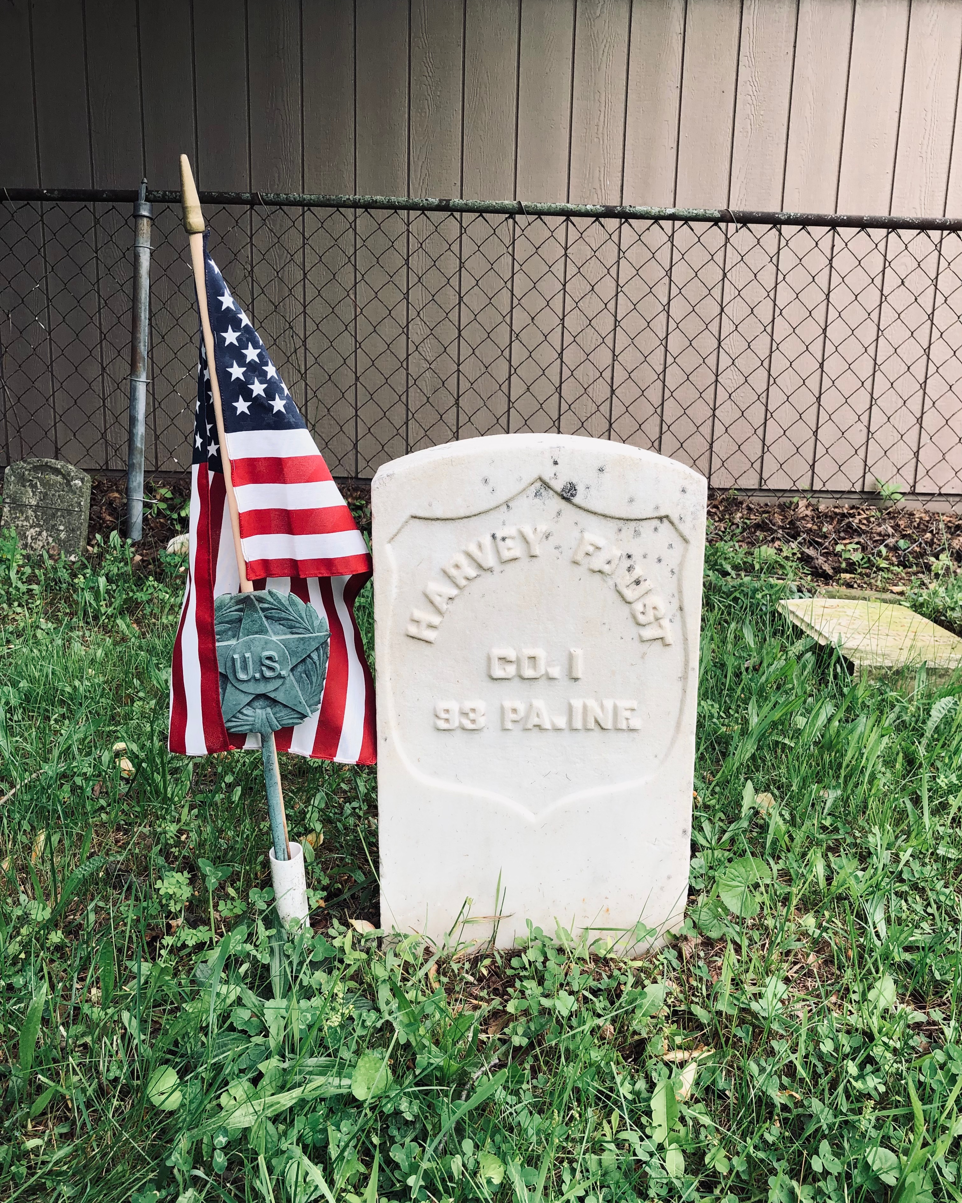
Monument Cleaning
Tombstone Restoration & Preservation

Slide 9
Repairing
Crack & Tablet Repair
Infilling
Stone Cutting
Base Reconstruction
The tombstone can be damaged in several ways, and most require bonding two or more pieces of the stone together and filling in missing sections. At times if a base is lost or damaged too much, a new keyway base can be made of concrete in a form. Stones that have broken at the bottom and are now on a harsh angle sometimes require cutting to sit straight.
Tombstone Restoration & Preservation

Slide 10
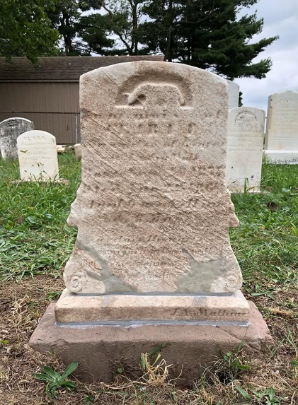
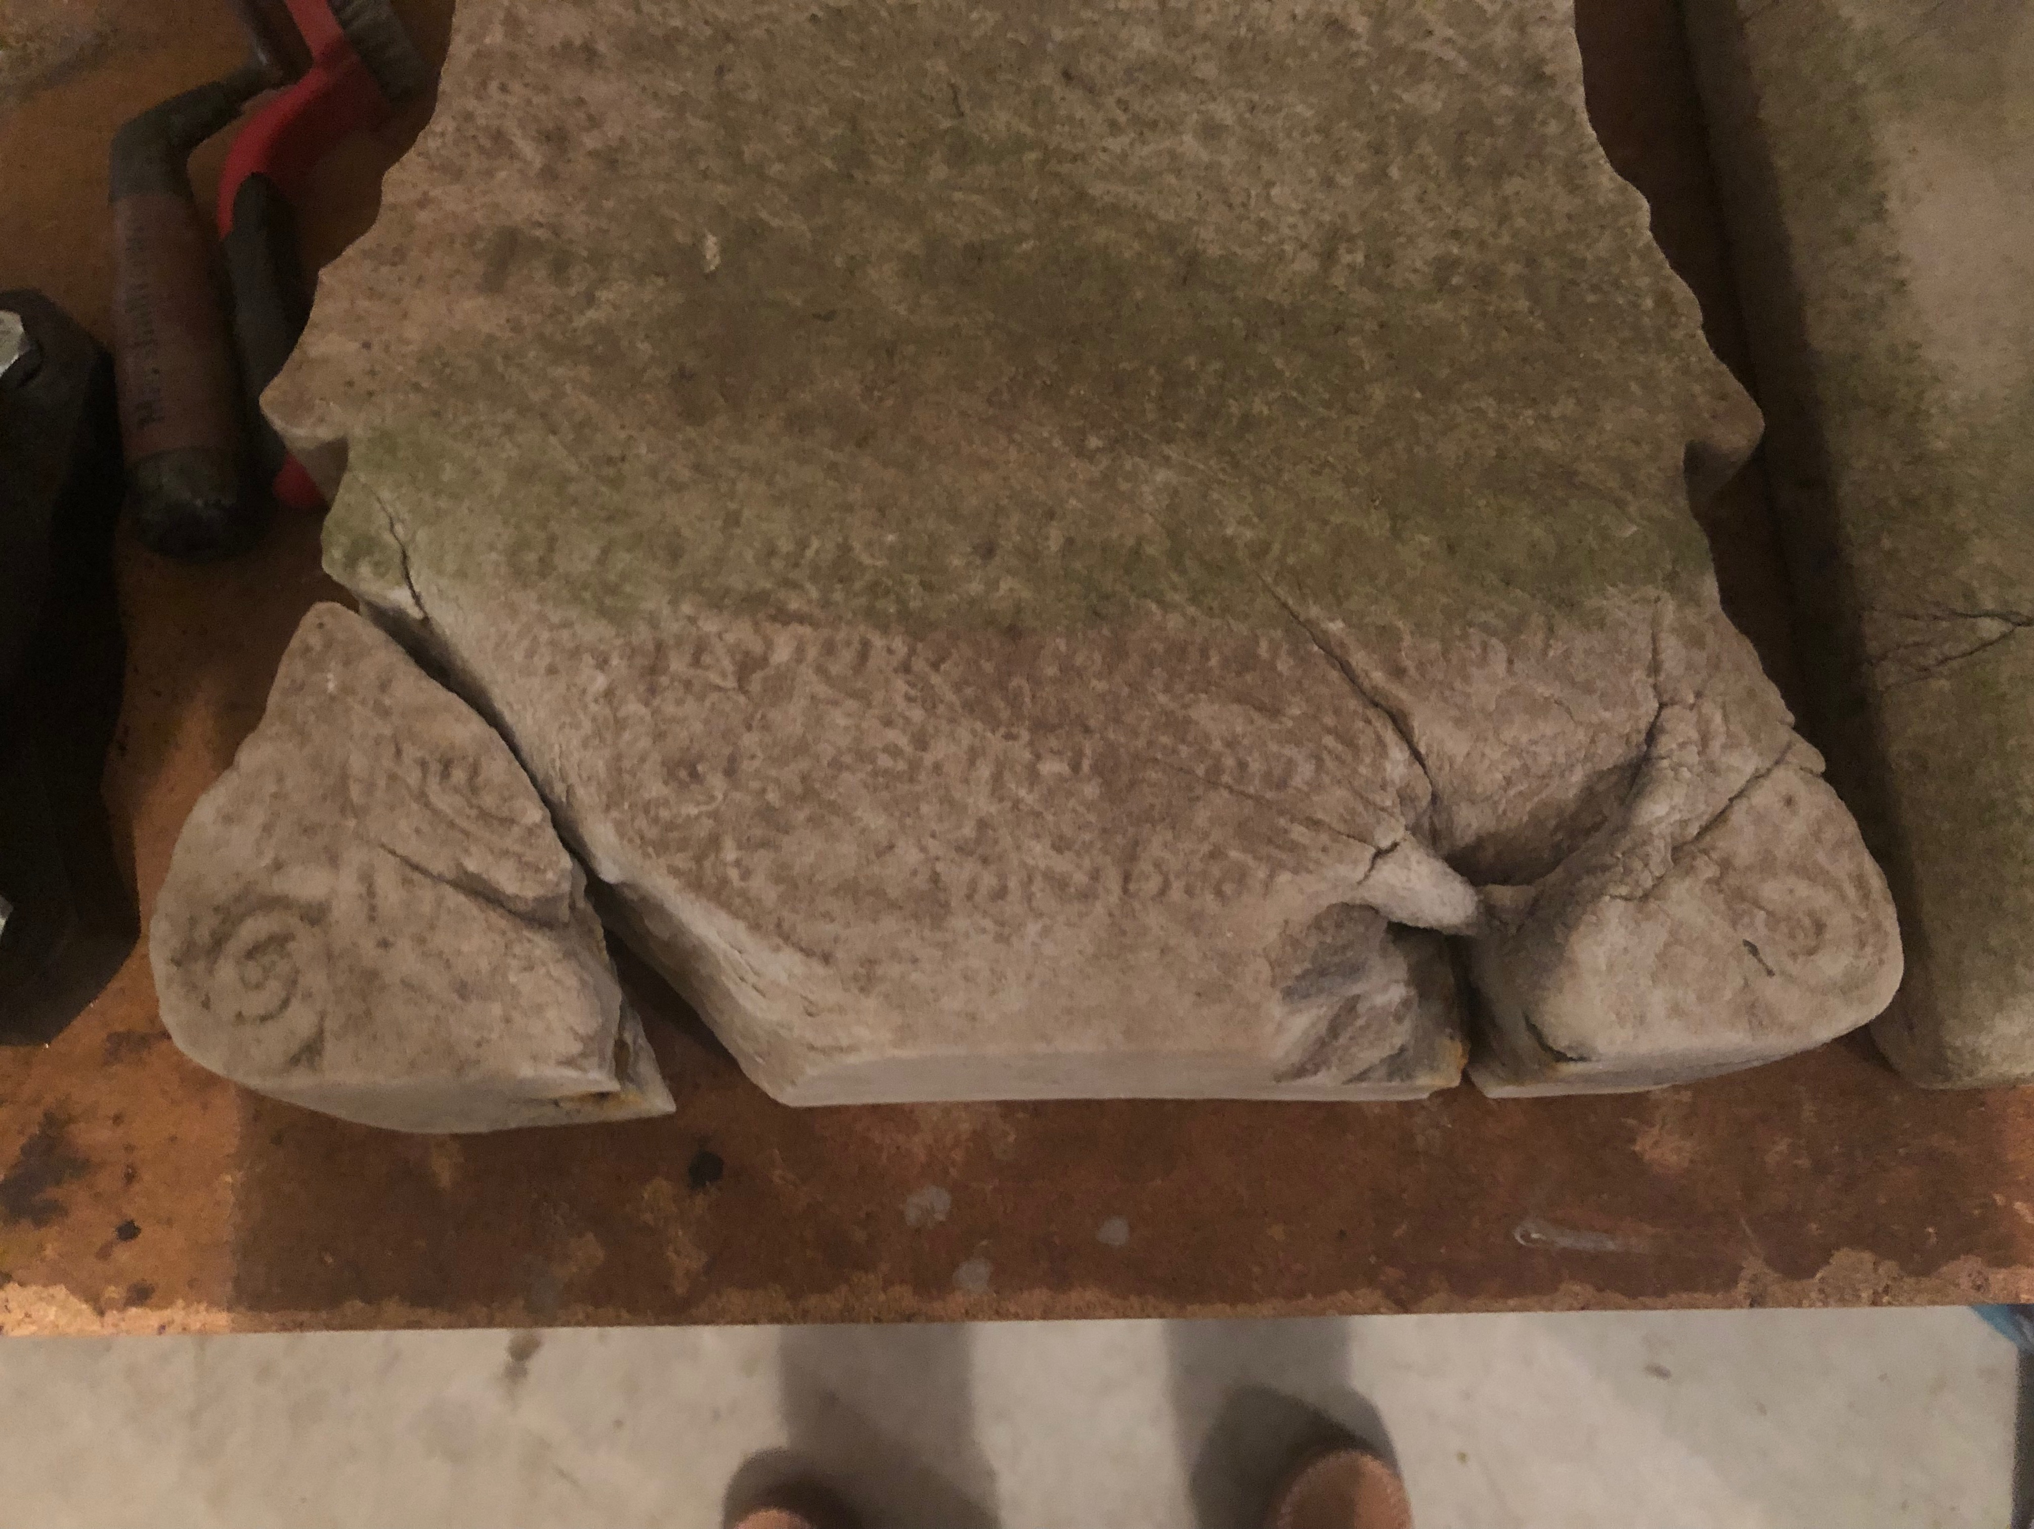
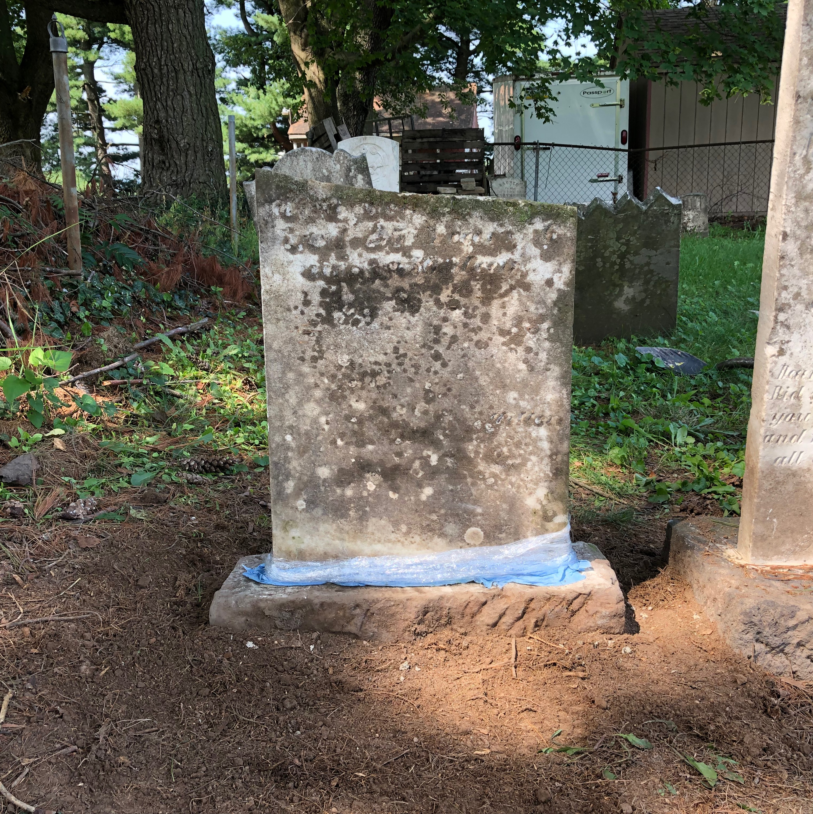
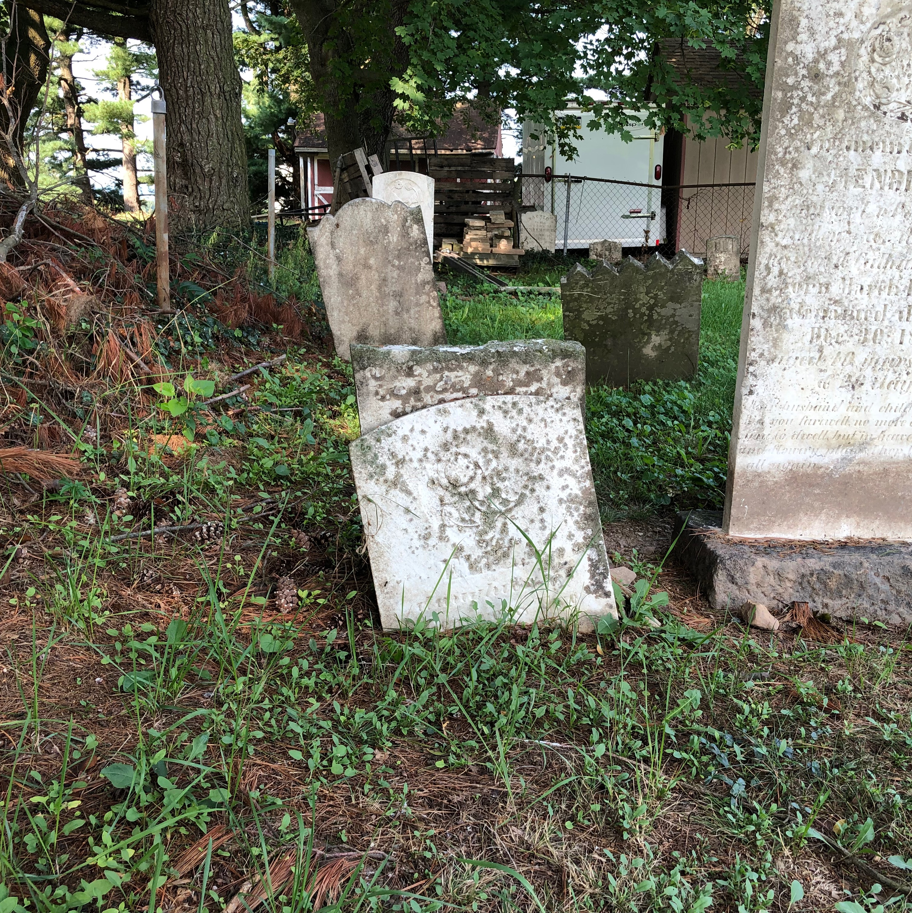
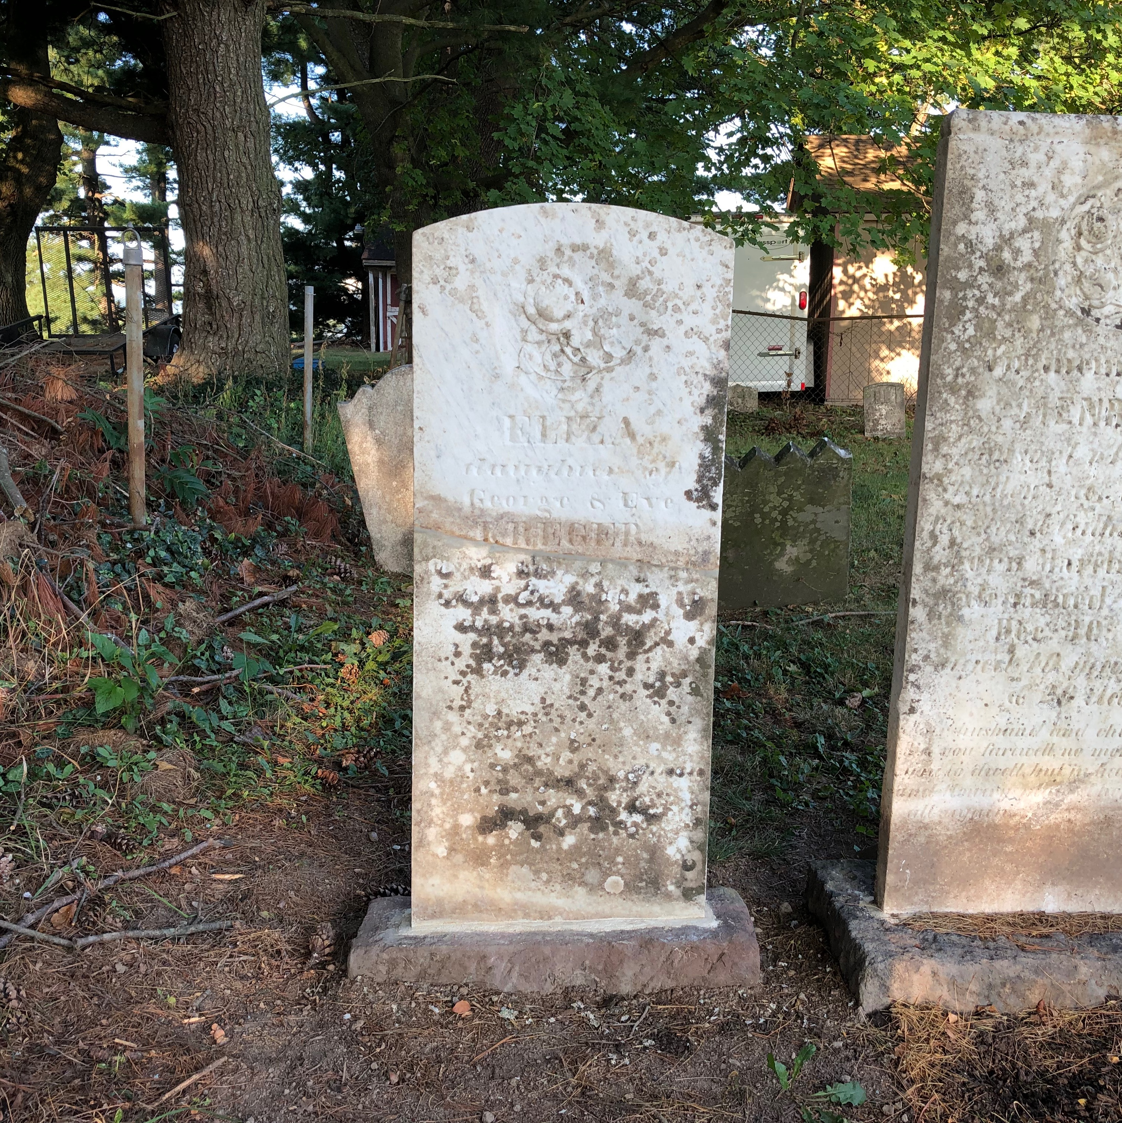
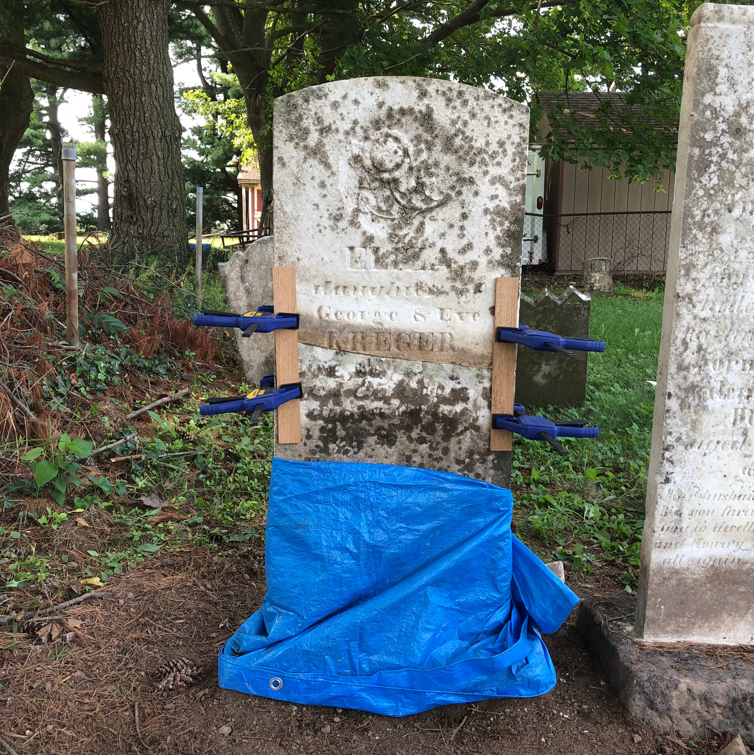
Repairing
Tombstone Restoration & Preservation

Slide 11
How To Get Involved
Visit & Contact Cemeteries
Join a Group (SAR)
Conduct Research
Cemetery work is in extreme need as there is an old cemetery just about every few miles from one another. Contacting a church, property owner, or establised cemetery preservationist is a perfect way to get started. Members in groups such as the Sons of the American Revolution tend to do this sort of work already. Videos, photos, and blogs are vital in learning on your own.
Tombstone Restoration & Preservation

Slide 12

Credits
This presentation, the photos and knowledge within it, were all sourced from Harris Ferry Chapter SAR President Jacob R. Lemon. It was presented at the 85th Annual Chapter Meeting on January 18, 2025. If anyone has any questions on procedure, materials, or just in general, feel free to utilize the following contact information:
Jacob R. Lemon
(717) 507-5364
jlemon93@hotmail.com
Tombstone Restoration & Preservation

